Slide 1
DEPARTMENT OF PHYSICS
SRM INSTITUTE OF SCIENCE AND TECHNOLOGY
18PYB103J –Semiconductor Physics
18PYB103J Module-II Lecture-1

Slide 2
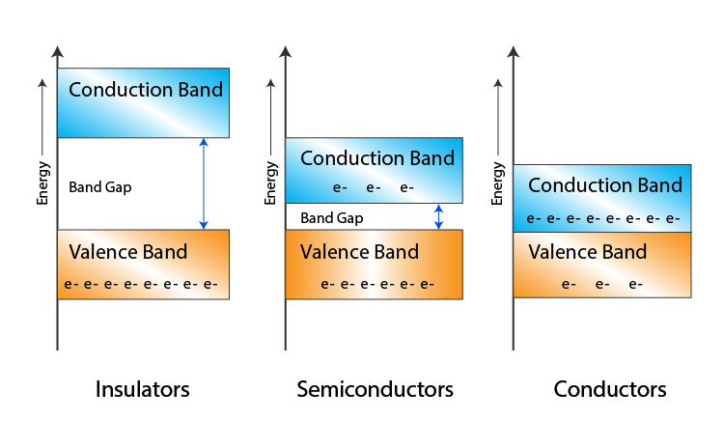
Intrinsic semiconductors: In semiconductors and insulators, when an external electric field is applied the conduction is not possible as there is a forbidden gap, which is absent in metals (good conductors).
The field that needs to move electron to conduction band is extremely large. Take the example of silicon, where the forbidden gap is about 1 eV. This is approximately the energy difference between a location close to an ion core and another location away from the ion core. The distance between these two locations is about 1 Å (10⁻¹⁰ m).
18PYB103J Module-II Lecture-1

Slide 3
Therefore, a field gradient of approximately 1V/ (10⁻¹⁰ m) = 10¹⁰ Vm⁻¹ is necessary to move an electron from the top of the valence band to the bottom of the conduction band. Such a high field gradient is not realizable in practice.
A pure crystal of silicon or germanium is an intrinsic semiconductor. The electrons that are excited from the top of the valence band to the bottom of the conduction band by thermal energy are responsible for conduction. The number of electrons excited across the gap can be calculated from the Fermi-Dirac probability distribution at temperature:
18PYB103J Module-II Lecture-1
Notes:
electrons excited across the gap can be calculated from the Fermi-Dirac probability distribution:

Slide 4
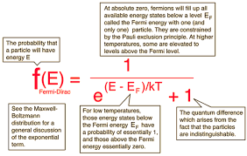
18PYB103J Module-II Lecture-1

Slide 5
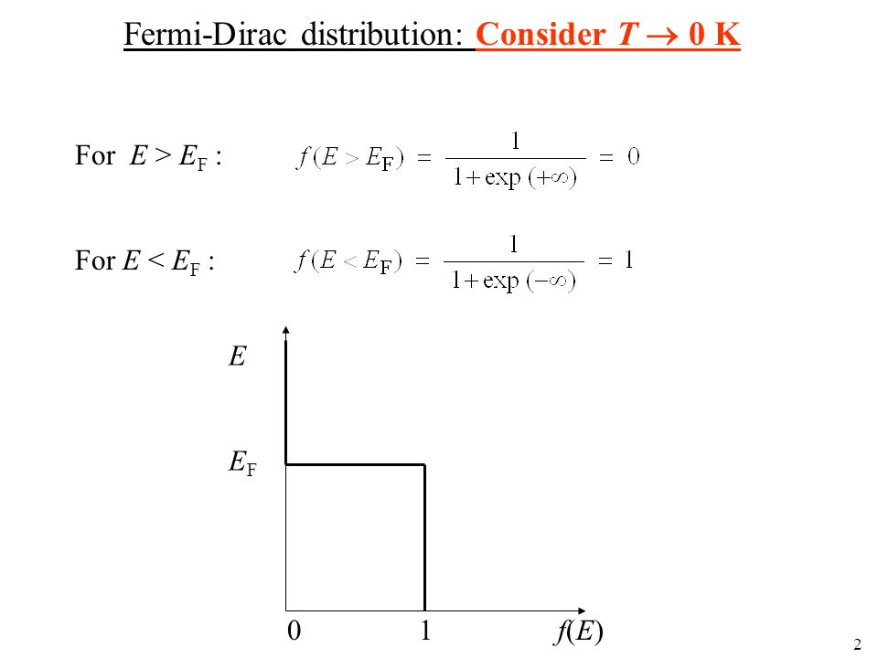
We can then write the conductivity σ of an intrinsic semiconductor
as:
σ_{i} = n_{e} e μ_{e} + n_{h} e μ_{h}
where e is the electronic charge, n_{e} and n_{h} are concentrations of electrons
and holes per unit volume.
18PYB101J Module-II Lecture-1

Slide 6
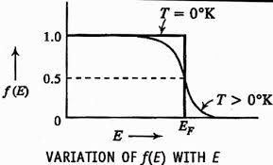
At absolute zero, all levels below E_{F} are completely filled
and all levels above E_{F} are completely empty.This level, which divides the filled and vacant states, is known as the Fermi energy level.
18PYB101J Module-II Lecture-1

Slide 7
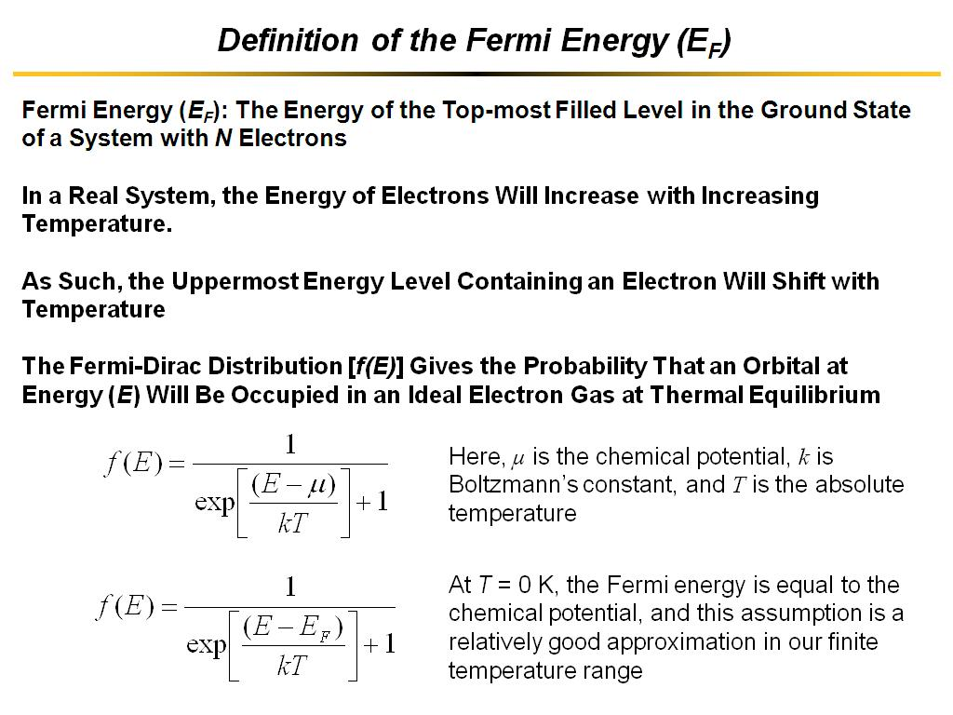
18PYB101J Module-II Lecture-1

Slide 8
The fraction of electrons at energy E is equal to the probability f(E). We can then write for the number n of electrons promoted across the gap:
n = N exp(−E_{g}/2k_{B}T).
where N is the number of electrons available for excitation from the top of the valence band. The promotion of some of the electrons across the gap leaves some vacant electron sites in the valence band. These are called holes. As each excited electron leaves back one hole, an intrinsic semiconductor contains an equal number of holes in the valence band and electrons in the conduction band, that is n_{e} = n_{h}. The number of each of these species is given by Equation(3). We can then write the conductivity σ of an intrinsic semiconductor as:
σ_{i} = n_{e} e μ_{e} + n_{h} e μ_{h} (4)
where e is the electronic charge, n_{e} and n_{h} are concentrations of electrons and holes per unit volume.
18PYB101J Module-II Lecture-1

Slide 9
Fermi level of Intrinsic semiconductor calculation:-
The number of free electrons per unit volume in an intrinsic semiconductor is n in conduction band and The number of holes per unit volume in an intrinsic semiconductor is p in valence band .
Since n = p in intrinsic semiconductors.
If we assume that, m*_e(mass of electron)=m*_h(mass of hole)
18PYB103J Module-II Lecture-1

Slide 10
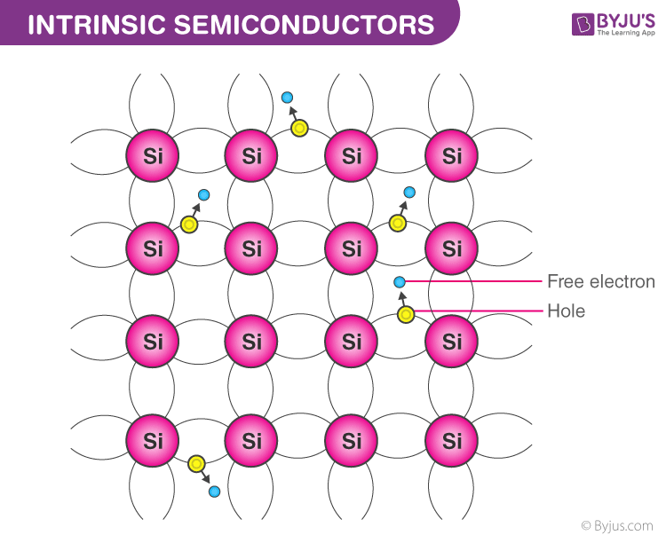
18PYB103J Module-II Lecture-1

Slide 11
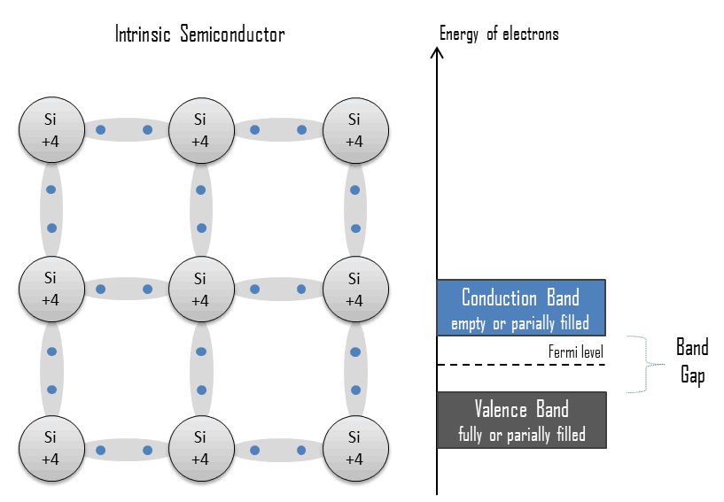
18PYB103J Module-II Lecture-1

Slide 12
18PYB103J Module-II Lecture-1

Slide 13
18PYB103J Module-IV Lecture-9

Slide 14
18PYB103J Module-IV Lecture-9

Slide 15
18PYB103J Module-II Lecture-1

Slide 16
E_{F}
18PYB101J Module-II Lecture-1

Slide 17
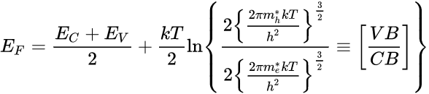
If we assume that,
[ since log_{e}1 = 0]
Thus, the Fermi level is located half way between the valence and conduction band and its position is independent of temperature. Since m_{h}* is greater than m_{e}*, E_{F} is just above the middle, and rises slightly with increase in temperature as shown in Fig. 1.4.
18PYB103J Module-II Lecture-1

Slide 18
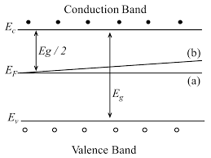
Fig.1.4. Position of Fermi level in an intrinsic semiconductor at various temperatures (a) at T = 0 K, the Fermi level in the middle of the forbidden gap (b) as temperature increases, E_{F} shifts upwards
18PYB1013J Module-II Lecture-1
Notes:
Fig1..4

Slide 19
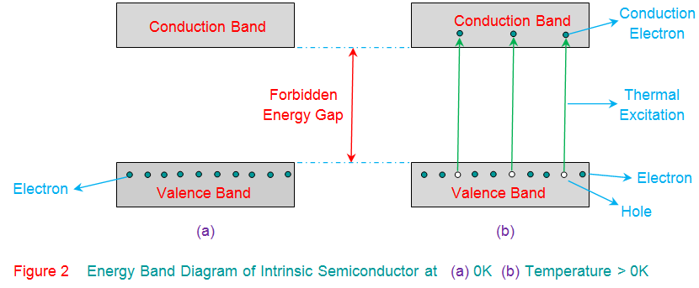
18PYB103J Module-II Lecture-1

Slide 20
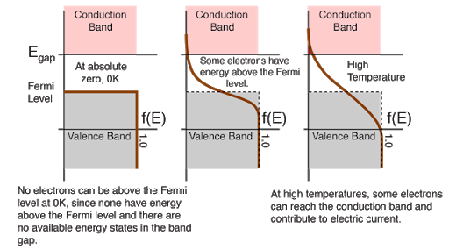
18PYB103J Module-II Lecture-1

